Slide 1
Riddhi Bhowmick

Slide 2

Question 1:
The average lead time is -3217.609.

Slide 3
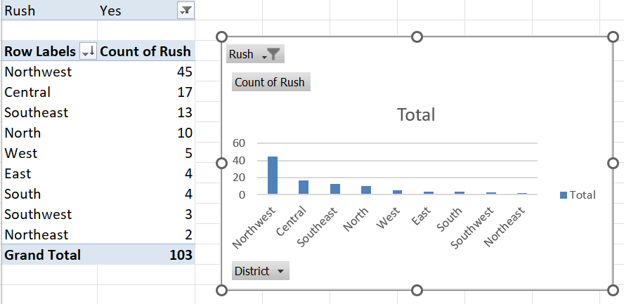
Question 2:
Answer: Northwest has the highest number of rush jobs.

Slide 4
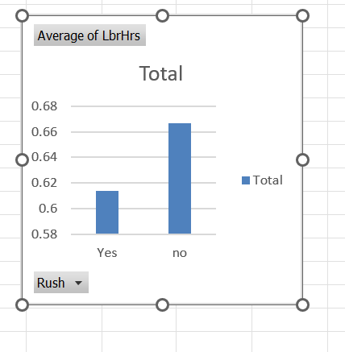
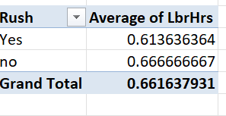
Question 3:
Answer: For the non-rush jobs the average time taken is 0.6 hrs while for the rush jobs the average time taken is 0.61 hrs.

Slide 5
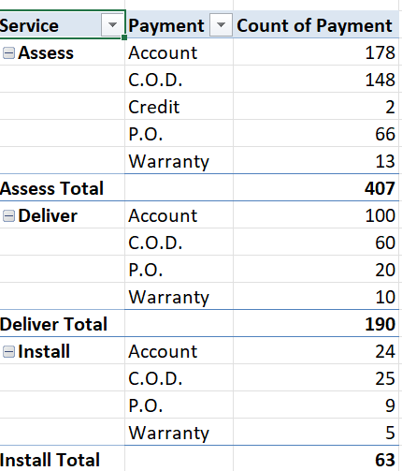
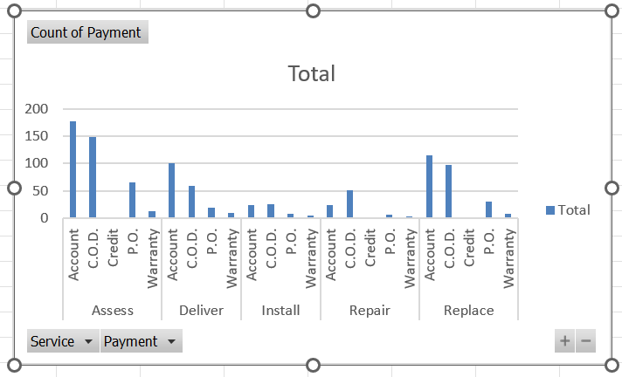
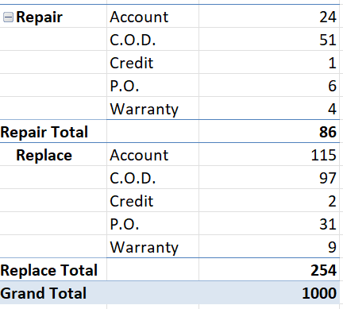
Question 4:
Answer: From the data it is understandable that most used payment type account in each case followed by C.O.D, and credit is the least used payment type( only found in assess and repair).

Slide 6
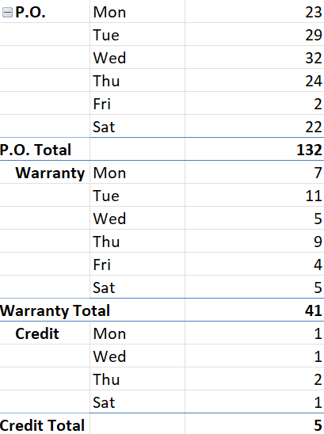
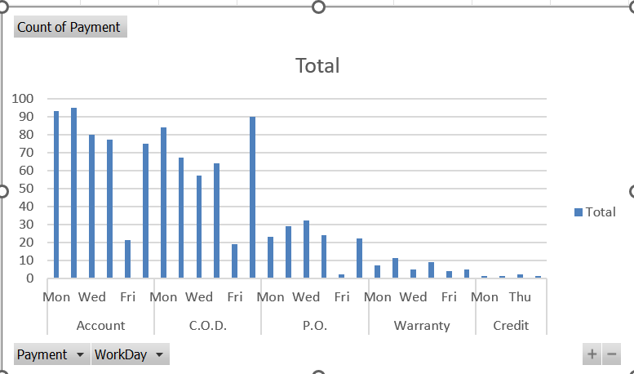
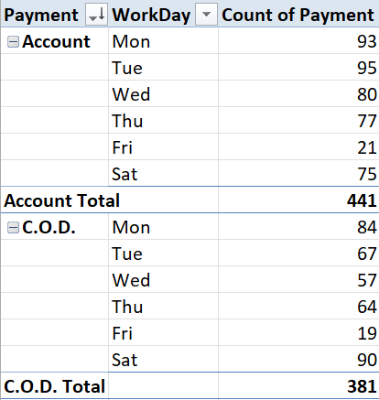
Question 5:
Answer:
Trends of payment across week data, states that most of the time the payment is done on the starting working days, i.e, Monday and Tuesday, and there is a gradual decrease in payment as the week progresses with the least amount of payment done on Friday. The trend is similar in every payment mode.

Slide 7
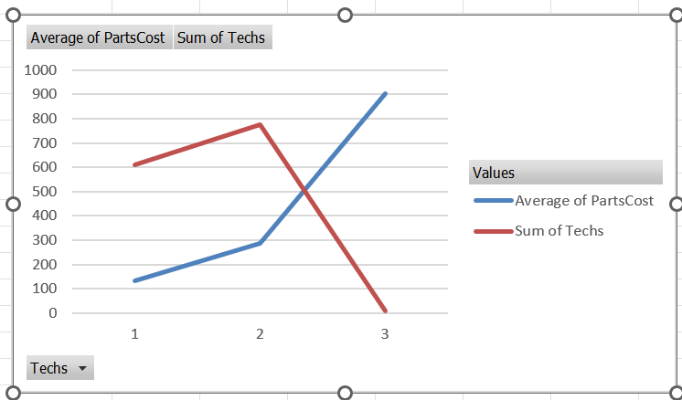
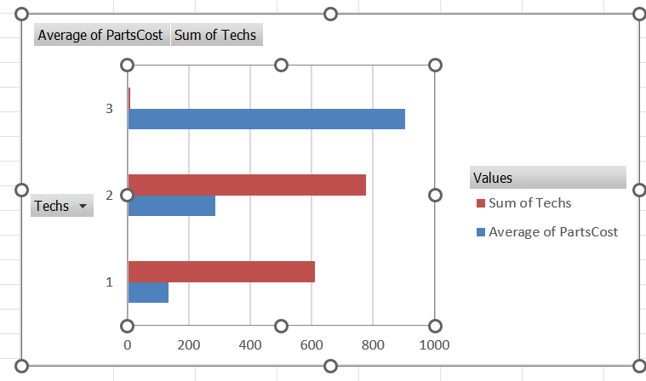
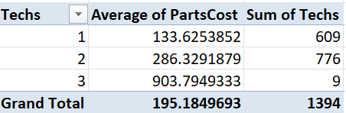
Question 6:
It is incomprehensible, due to lack of even distribution of data in the count of techs. However, from the data available it is understandable the average parts cost increases with the increase in number of techs.

Slide 8
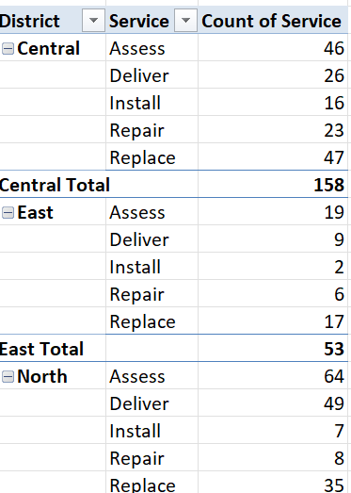
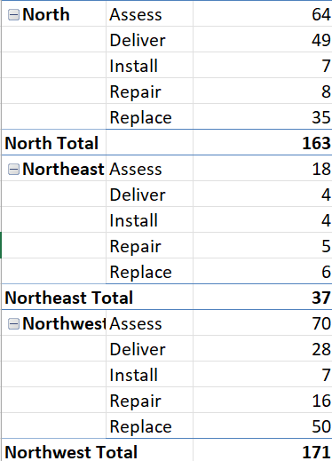
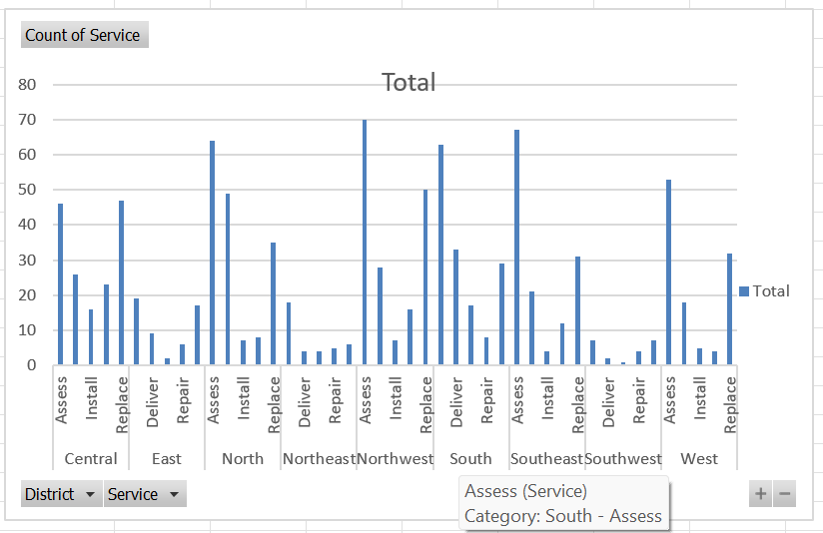
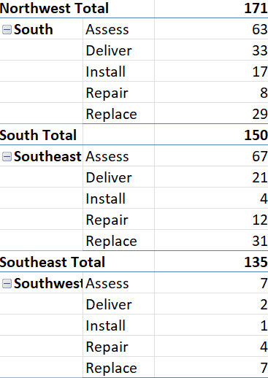
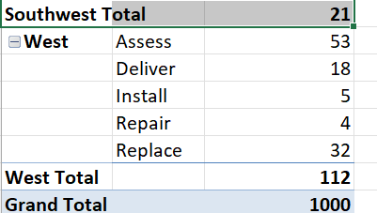
Question7:
Answer: The most common type of service requested is “ASSESS” in each and every district.
The second most common service is “Deliver”.

Slide 9
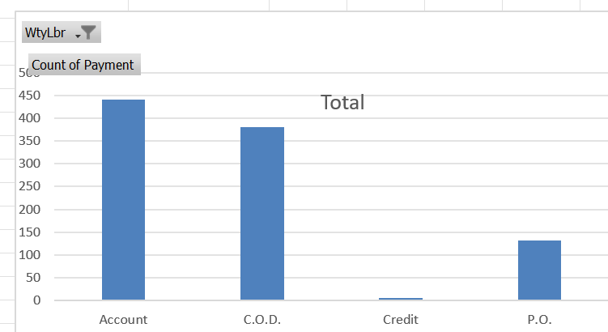
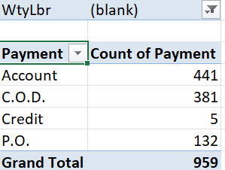
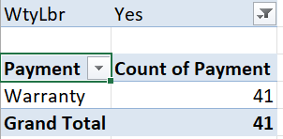
Question 8: Yes there is a difference in payment without warranty labour, incase of warranty labour the payment is done trough warranty method and in case of without warranty labour the payment is done in account, cod, credit and P.O method.

Slide 10
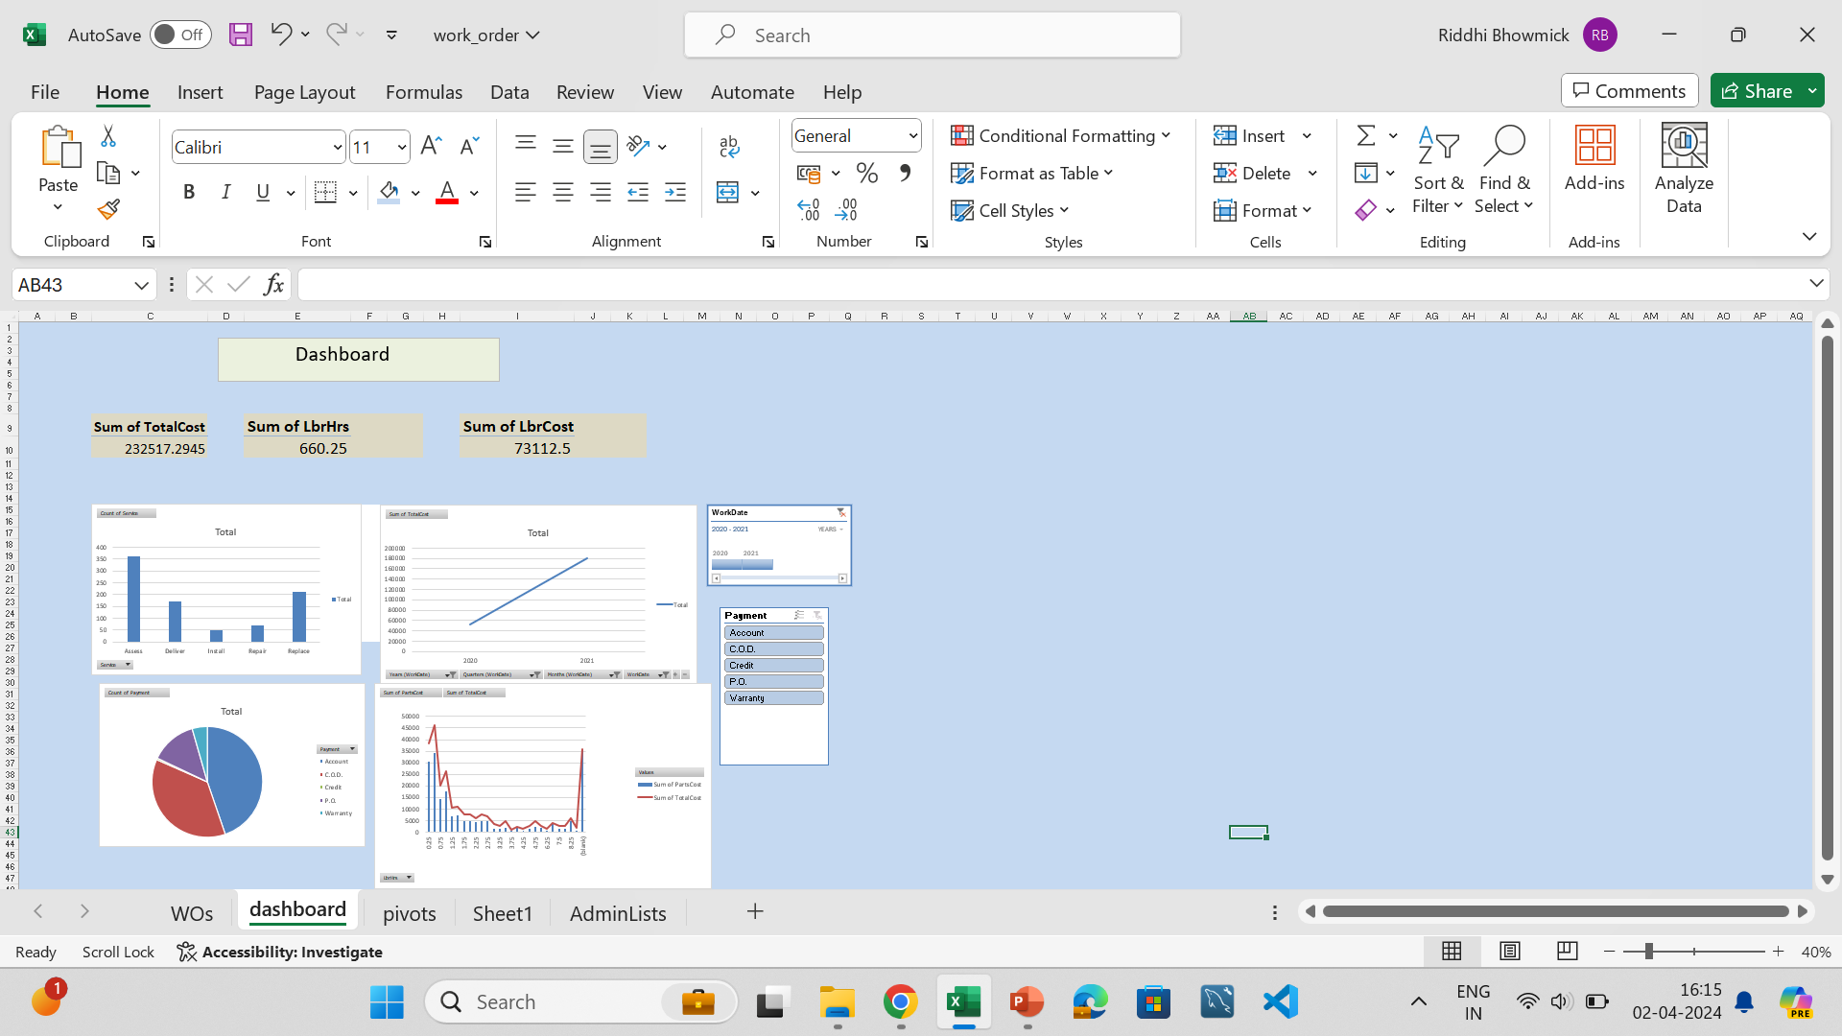
Question 9:
Dashboard: The first chart shows count of service in each time period as decided by the user. The pie chart shows the cost of payments for each sector,, Then line chart shows the cost of service in each year or month as selected. The combo chart shows the sum of parts cost(blue) and the sum of total cost(red). The slicer and the timeline is connected for all the charts and the cards that display the total cost total labour hours and labour cost for the timeline.

Slide 11
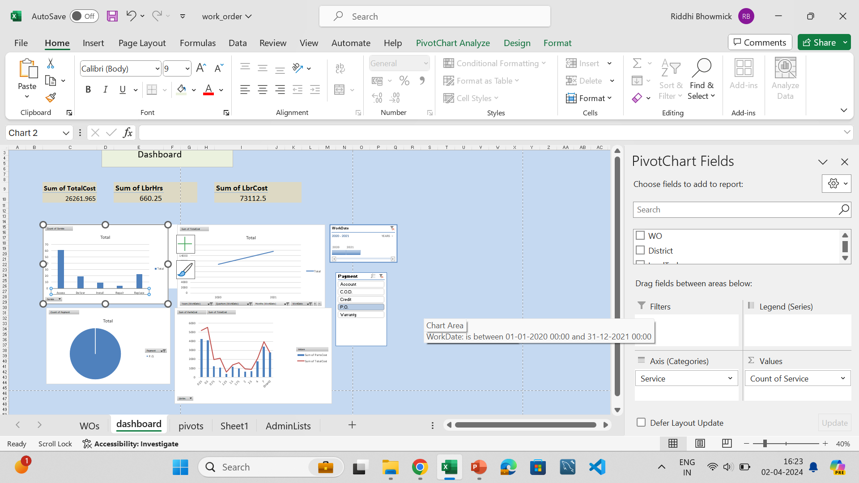
With the change in slicer to P.O, the graphs change accordingly for the given timeline and so does the cards.

